Slide 1

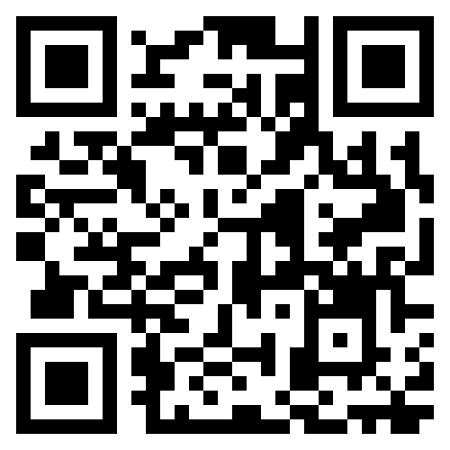
Log your attendance online!
4. Check in with the code
Go to HTTPS://BOURNEMOUTH.LA.JISC.AC.UK/
Press ‘Log in’ and enter your email address.
Log in with your BU username and password.
994509
The code is only active for the duration of the session.
Problems logging your attendance?
Need support?
Contact the IT Service Desk after this session.
https://itservices.bournemouth.ac.uk
Notes:
Option 2: QR code. Add your session code to the Checkin code box.

